Slide 1
Sales Analysis 360 Project By : Abhay Vardhan Pandey

Slide 2
1. Project Overview And Summary
Comprehensive sales analytics solution covering revenue, margin, customer behavior, store performance, and product trends. - Uses SQL for extraction, Python for cleaning and EDA.
2. Objective Understand sales across products, categories, stores, regions. - Identify growth opportunities and inefficiencies. - Highlight customer purchase patterns.
3. Tools & Technologies Used - SQL, Python, Pandas, NumPy, Matplotlib, Seaborn.
4. Data Sources - Orders, Product Master, Customer Master, Store Master, Returns.

Slide 3
2.KPIs: Sales, Margin%, GMV, AOV, Units Sold, Repeat Rate, Return Rate
Total Sales: 108913849.91
Total GMV: 128133941.22
Units Sold: 50285 AOV: 5445.69
Margin %: -15.47
Repeat Rate %: 92.60
Return Rate %: 7.47

Slide 4
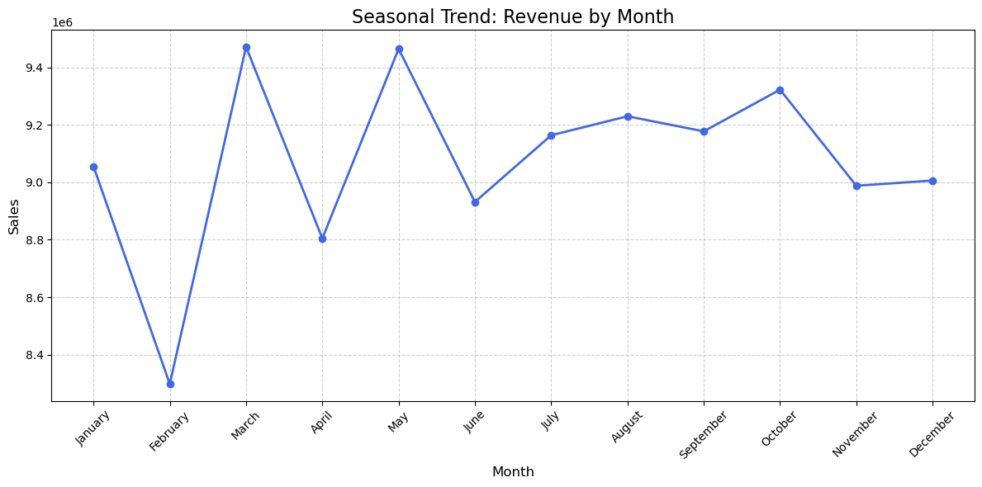
Seasonal Trend: Revenue by Month: January 9055508.48 February 8298269.92 March 9471519.30 April 8804584.72 May 9464628.24 June 8931666.70 July 9163736.81 August 9229816.43 September 9177392.63 October 9322530.67 November 8987982.99 December 9006213.03

Slide 5
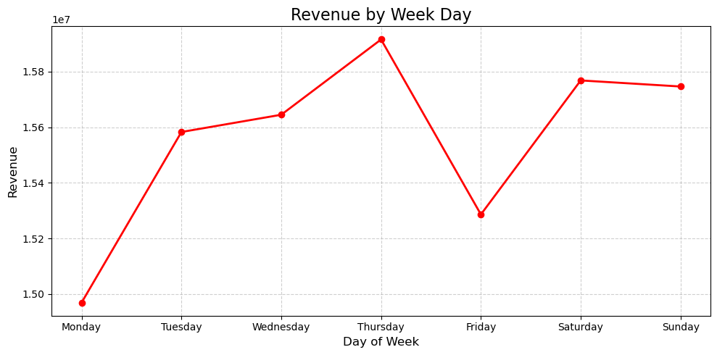
Seasonal Trend: Revenue by Week Day :
In Weekends and mid-week like (Wednesday, Thursday) show higher revenue, Its indicates strong consumer activity during these period.

Slide 6
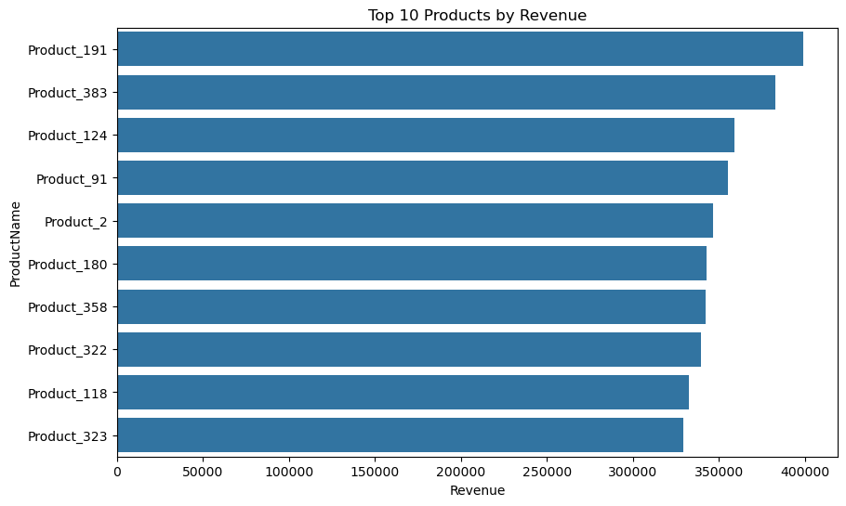
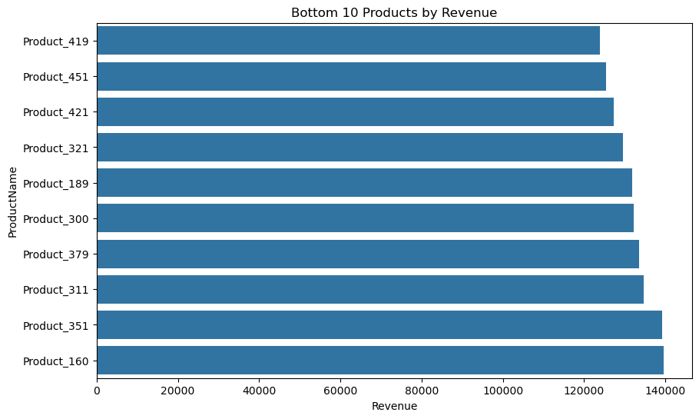
Business Requirement:
Top and Bottom SKUs : It is Identify to top and bottom selling products is vital for inventory management, marketing focus, and product development strategies.
Product_191, Product_383, and Product_124 are top selling products, which indicates strong market demand and customer preference.
Bottom performing product are require immediate attention for potential discontinuation, repricing, or marketing adjustments

Slide 7
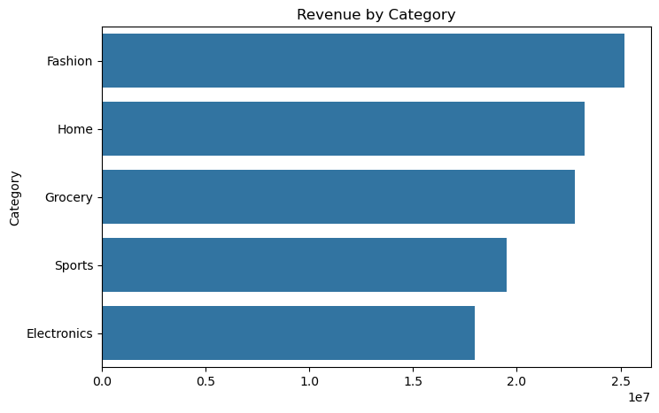
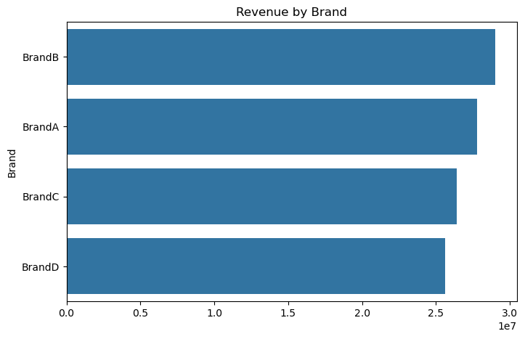
Category-wise Revenue : In this Fashionable or fashion related category are doing very well and electronics item look to root cause analysis why there revenue is not good.
Brand – Wise Revenue : Brand B is doing very well and brand D is as not good compare to A so brand D also doing some why why analysis

Slide 8
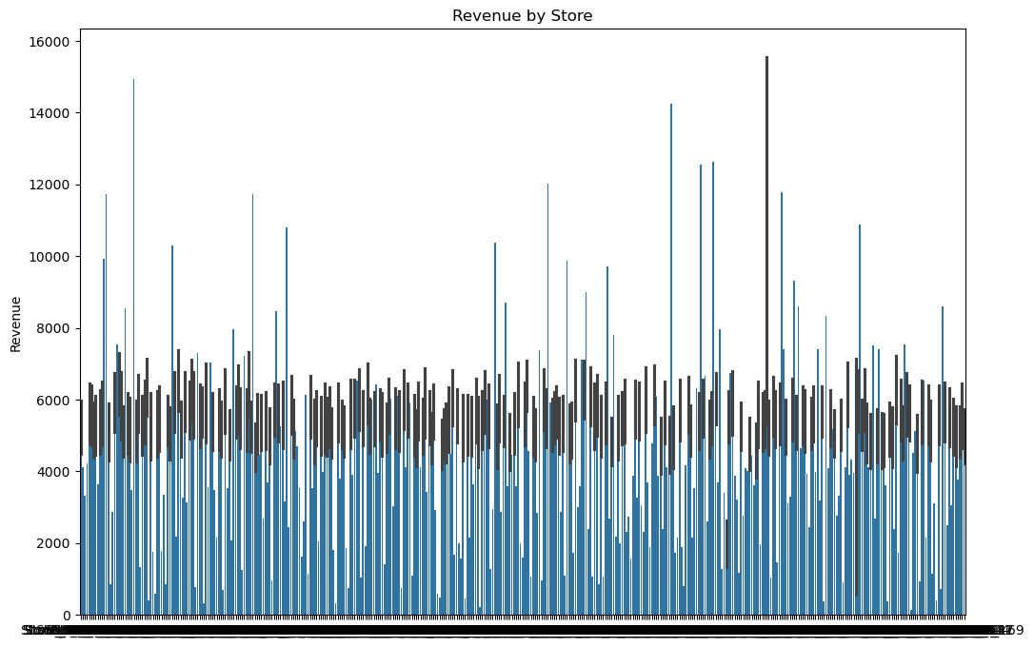
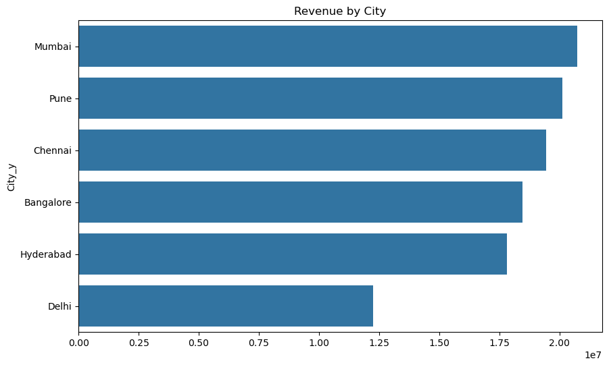
Store & Region Analysis : Store_18, Store_145, and Store_3 are consistently among the top performers, contributing significantly to overall revenue.
City – Wise Revenue :
City like Mumbai and Pune are top performance in revenue and Delhi look what happened why customer not like or what are the region behind.

Slide 9
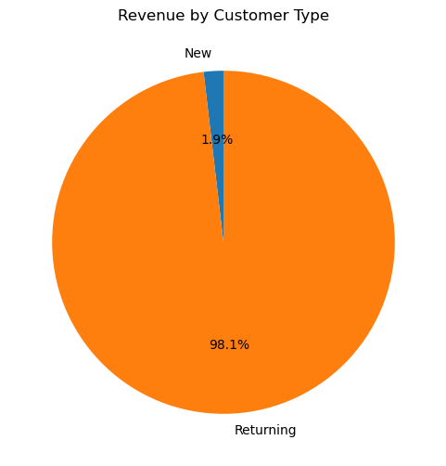
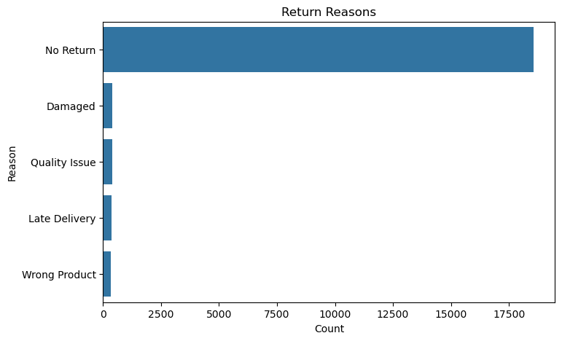
Customer Insights & Return Analysis : Returning customers typically generate more revenue because they trust your brand, are familiar with the product, respond to marketing, and purchase more consistently, whereas new customers are still exploring.
Return Reason:
Improve product quality
Update descriptions and sizing info
Reduce shipping issues
Target customer satisfaction initiatives

Slide 10
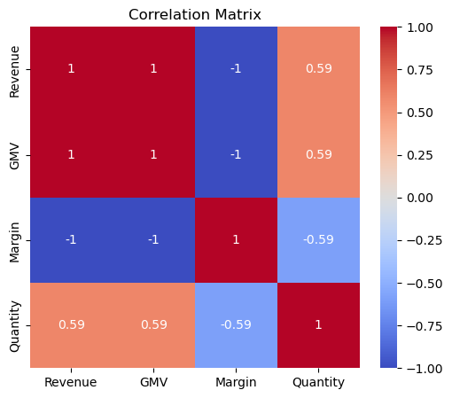
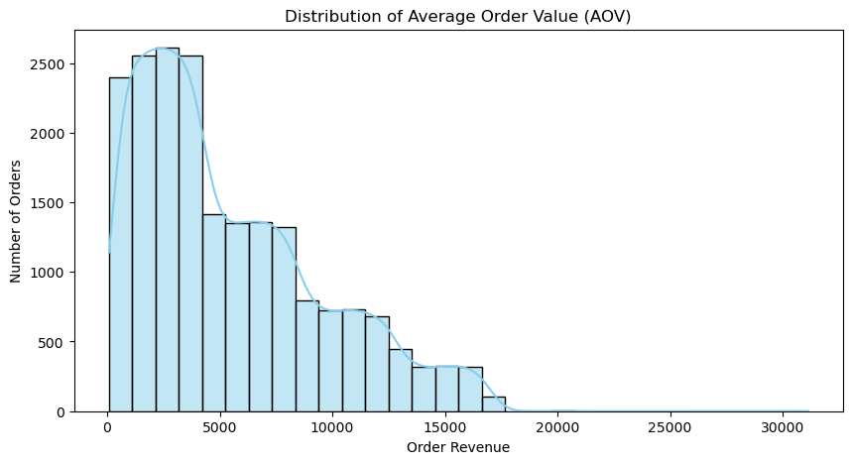
Correlation Analysis :
EDA Analysis :
AOV Distribution :

Slide 11
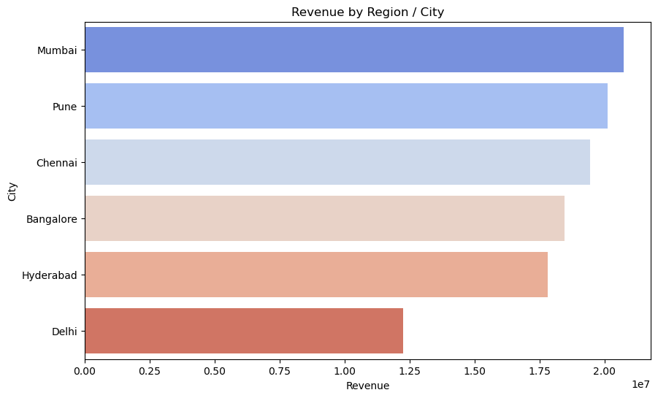
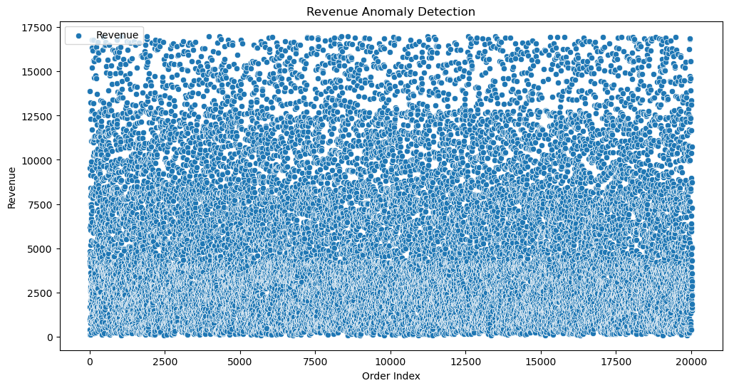
Region Revenue Heatmap (Bar Chart) :
Visualize anomalies :

Slide 12
Recommendations:
Prioritize inventory and marketing for top products.
Target low-performing regions with campaigns
Retain high-value customer segments
Reduce returns through product quality checks / better descriptions / better offers.
Increase stock for top SKUs.
Target high-value customers.
Allocate budget to strong regions.
Reduce discounts on low-margin items to protect profitability.
Launch retention programs since returning customers drive more revenue. Improve product visibility for high-margin but low-sales items.
Prepare inventory and staff ahead of peak seasonal months.
Enhance customer experience through faster delivery and better support

Slide 13


